Slide 1
Bayesian Modeling

Slide 2
Bayesian Modeling-Statistics
Classical statistics provides methods to analyze data, from simple descriptive measures to complex and sophisticated models. The available data are processed and then conclusions about a hypothetical population of which the data available are supposed to be a representative sample are drawn.
Suppose, for example, we need to guess the outcome of an experiment that consists of tossing a coin. How many biased coins have we ever seen? Probably not many, and hence we are ready to believe that the coin is fair and that the outcome of the experiment can be either head or tail with the same probability.
On the other hand, imagine that someone would tell us that the coin is forged so that it is more likely to land head. How can we take into account this information in the analysis of our data?

Slide 3
Bayesian Modeling-Statistics
Bayesian methods provide a principled way to incorporate this external information into the data analysis process. To do so, however, Bayesian methods have to change entirely the vision of the data analysis process with respect to the classical approach. In a Bayesian approach, the data analysis process starts already with a given probability distribution. As this distribution is given before any data is considered, it is called prior distribution.

Slide 4
Bayesian Modeling-Statistics
Bayesian statistics is a mathematical procedure that applies probabilities to statistical problems. It provides people the tools to update their beliefs in the evidence of new data.
Suppose, out of all the 4 championship races (F1) between Niki Lauda and James hunt, Niki won 3 times while James managed only 1.
So, if you were to bet on the winner of next race, who would he be ?
I bet you would say Niki Lauda.
Here’s the twist. What if you are told that it rained once when James won and once when Niki won and it is definite that it will rain on the next date. So, who would you bet your money on now ?
By intuition, it is easy to see that chances of winning for James have increased drastically. But the question is: how much ?

Slide 5
Bayesian Modeling-Statistics
Bayesian Statistics
Conditional Probability
Bayes Theorem

Slide 6
Conditional Probability
Conditional probability is known as the possibility of an event or outcome happening, based on the existence of a previous event or outcome. It is calculated by multiplying the probability of the preceding event by the renewed probability of the succeeding, or conditional, event.
The probability of occurrence of any event A when another event B in relation to A has already occurred is known as conditional probability. It is depicted by P(A|B).

Slide 7
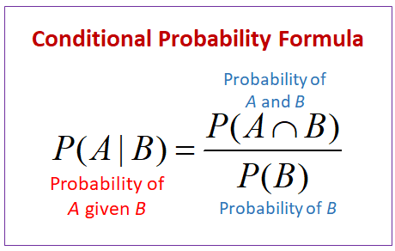
Conditional Probability
U
A
A ∩ B
B
40 students like Apple
30 students like orange
20 students like both

Slide 8
Conditional Probability

Slide 9
Bayes Theorem
Bayes’’theorem is a mathematical formula used to determine the conditional probability of the events.
Bayes theorem describes the probability of an event based on prior knowledge of the conditions that might be relevant to the event.
Invented – Thomas Bayes
Year- 1763

Slide 10
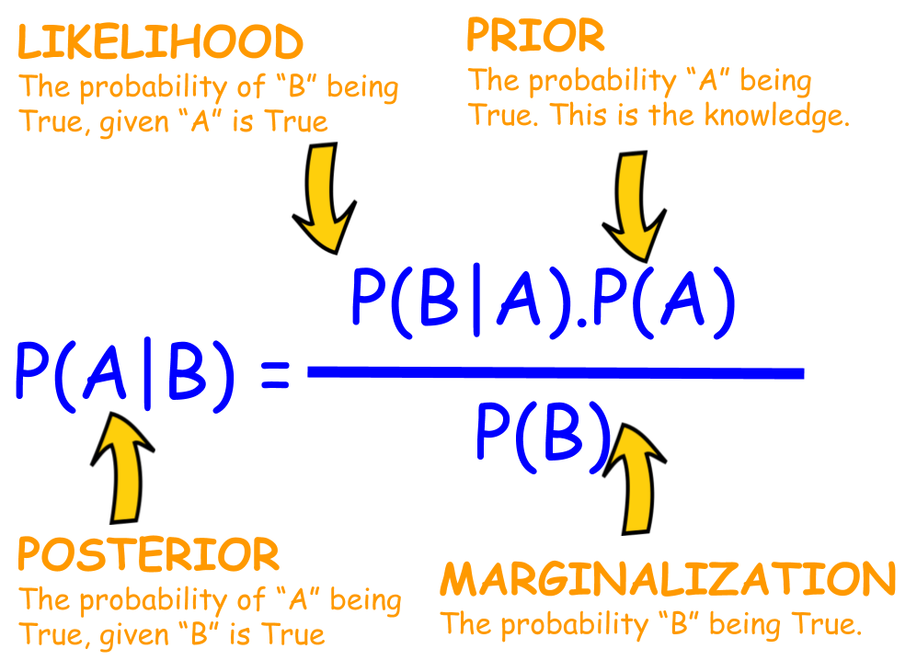
Posterior P(A|B)=> Probability of event A being True, given event B has already accrued.
Likelihood P(B|A)=> Probability of the evidence given that the hypothesis is True.
Prior P(A)=> Probability of hypothesis before considering the evidence.
Marginal P(B)=> Probability of evidence/Data.

Slide 11
Bayes Theorem
P(A|B)- Probability of hypothesis A, given that evidence or data B.
P(B|A)- Probability of data/evidence, given that hypothesis is true.
P(A)- Probability of A
P(B)- Probability of B

Slide 12
Bayes Theorem
For Example:
Calculate P(King|Face)------Posterior Probability

Slide 13
Naïve Bayes
Naive Bayes algorithm is a classification technique based on Bayes’ theorem, which assumes that the presence of a particular feature in a class is unrelated to the presence of any other feature. There are various applications of this algorithm including face recognition, NLP problems, medical diagnoses and a lot more.

Slide 14
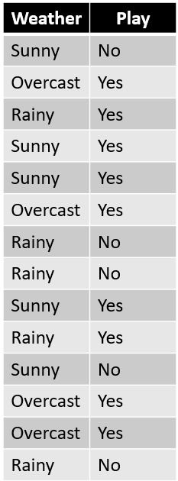
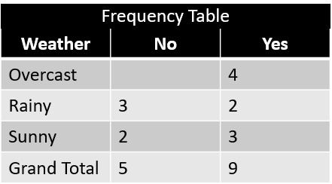
Naive Bayes example:
Below is training data on which Naive Bayes algorithm is applied:
Step 1: Make a Frequency table of the data.

Slide 15
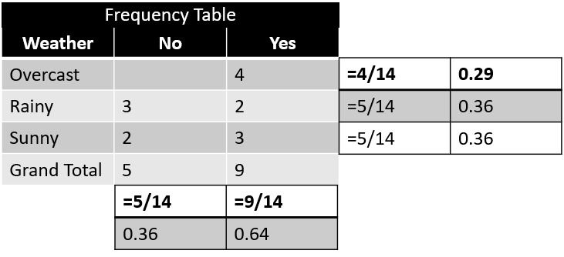
Step 2: Create a Likelihood table by finding probabilities like Overcast probability = 0.29.
Step 3: Use Naive Bayes equation to calculate the posterior probability for each class. The class with the highest posterior probability is the outcome of prediction.

Slide 16
Problem: Players will play if the weather is Rainy. Is this statement correct?
You can solve it using the above discussed method of posterior probability.
P(Yes | Rainy) = P( Rainy | Yes) * P(Yes) / P (Rainy) Here, you have P (Rainy |Yes) = 2/9 = 0.22, P(Rainy) = 5/14 = 0.36, P(Yes)= 9/14 = 0.64
Now, P (Yes | Rainy) = 0.22 * 0.64 / 0.36 = 0.39, which has a higher probability.
Naive Bayes uses a similar method to predict the probability of different classes based on various attributes. This algorithm is mostly used in NLP problems like sentiment analysis, text classification, etc.

